Slide 1

DEE 4544 DIGITAL ELECTRONICS Chapter 8: Logic Families
By : Dr. Noraisyah Tajudin
Email: noraisyahtajudin@lincoln.edu.my
Faculty of Engineering
Lincoln University College (LUC)
LECTURE 8
DATE : MAY 2024

Slide 2

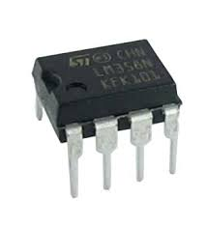
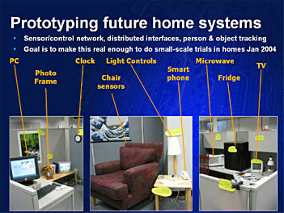
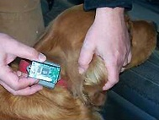
INTRODUCTION
Logic gates are available in the form of Integrated circuit( IC’s)
As per the level of integration, the IC’s can accommodate a greater number of logic gates and digital functions.
These forms are referred as logic family

Slide 3
Classification of Logic Families
Digital Logic Families
Bipolar logic family
Saturated
Non Saturated
Uni polar logic family
Resistor Transistor Logic(RTL)
Direct coupled transistor logic(DCTL)
Integrated Injection Logic(IIL)
Diode Transistor Logic (DTL)
High Threshold Transistor Logic
Transistor – Transistor Logic (TTL)
Standard TTL
High Power TTL
Low Power TTL
Low Power Schottly
Schottly
Schottly TTL
Emitter Coupled Logic (ECL)
P MOS
N MOS
C MOS

Slide 4
Important points
The digital familiy is categorized by two types (i)Bipolar and (ii) Unipolar
In Saturated Bipolar logic families, the transistor in the IC driven in to saturation. In Non Saturated Bipolar logic families, the transistor in the IC not driven in to saturation
In PMOS & NMOS Unipolar logic family only P & N channel MOSFETs are used. CMOS Unipolar logic family both P& N- channel MOSFETs are used.
All family same logic level & same Voltage.

Slide 5
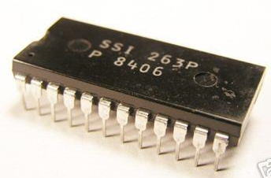
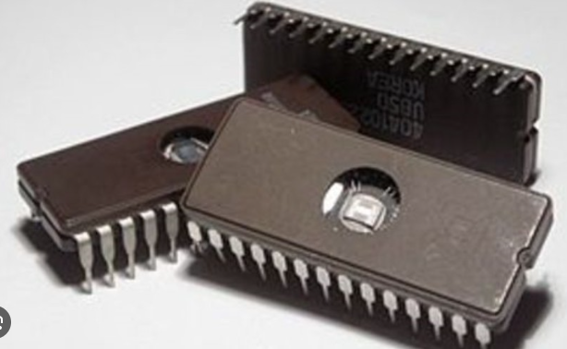
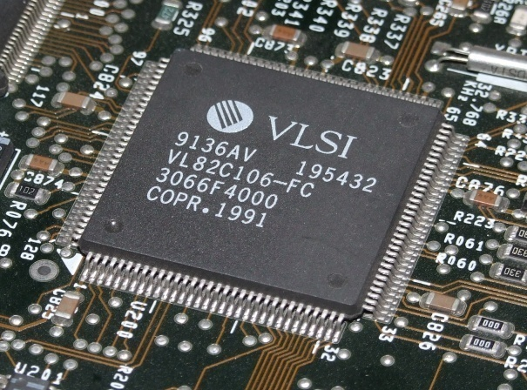
Level of integration
Number of gates fabricated in single IC
There are 4 generation
Small Scale Integration (SSI) = 12 gates in 1 Chip
Medium Scale Integration (MSI) = 12 to 100 gates
Large Scale Integration(LSI)= 100 to 1000 gates
Very Large-Scale Integration(VLSI)= Up to 1,00,000 or more

Slide 6
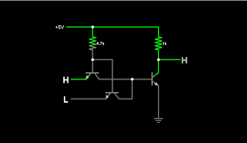
TRANSISTOR –TRANSISTOR LOGIC (TTL) CIRCUIT
The most widely used logic family is Transistor – Transistor Logic (TTL)
It has Bipolar Transistor
High Speed(tp= 10 ns)
Low power dissipation
Fan – In from 12 -14
Fan out equals to 10 or more

Slide 7
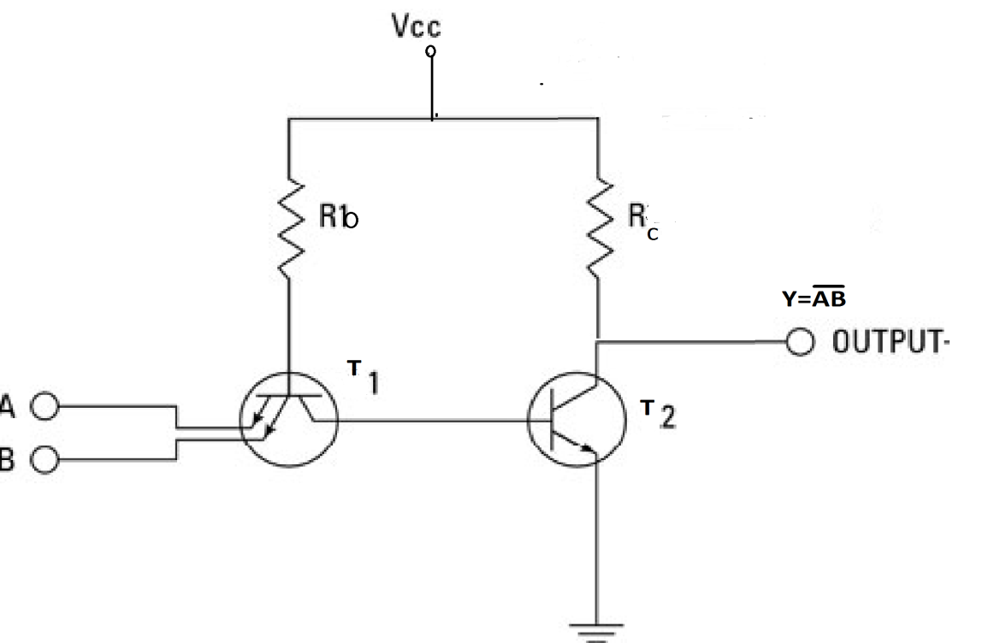
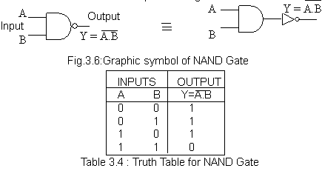
TTL NAND GATEs
The multi emitter transistor T1 is used to drive the output of T2
Inputs are given in Emitter of T1& output is taken from Collector of T2.
Circuit of Emitter Coupled Logic

Slide 8
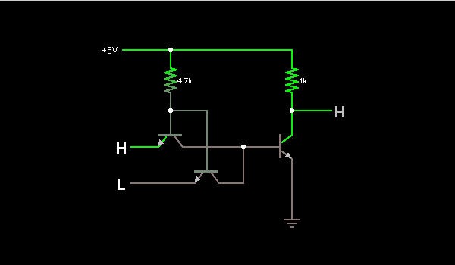
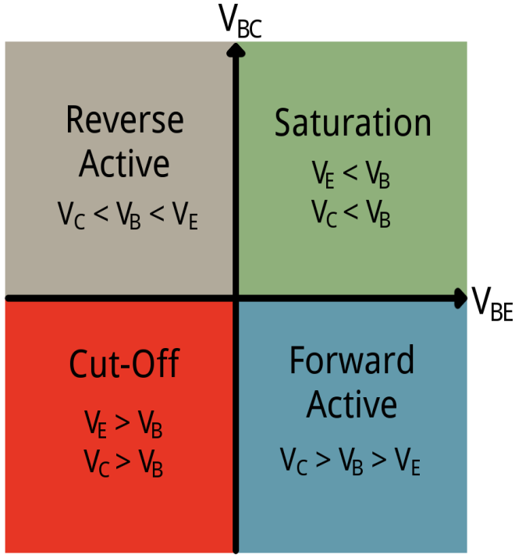
Operation
If one of the input is ‘0’(LOW), the corresponding Emitter juction is forward biased (VE< VB) So T1 is in Saturation region (ON) & collector also biased to conduct but the voltage is low(0.3V) , this forces T2 OFF. Because the collector voltage of T1 is Base voltage of T2. So the output taken from the collector of T2 is HIGH ie “1”
If both the input is HIGH then both emitter reverse bias so T1 is in CutOff (OFF) region , this increases collector voltage of T1 that Pulls T2 to Saturation (ON) thus the output is LOW(0)
EMITTER INPUT | T1 | T2 | COLLECTOR OUTPUT
0,0 0,1 1,0 | SATURATION ON | OFF | HIGH= 1 HIGH= 1 HIGH= 1
1,1 | CUT OFF OFF | SATURATION ON | LOW = 0

Slide 9
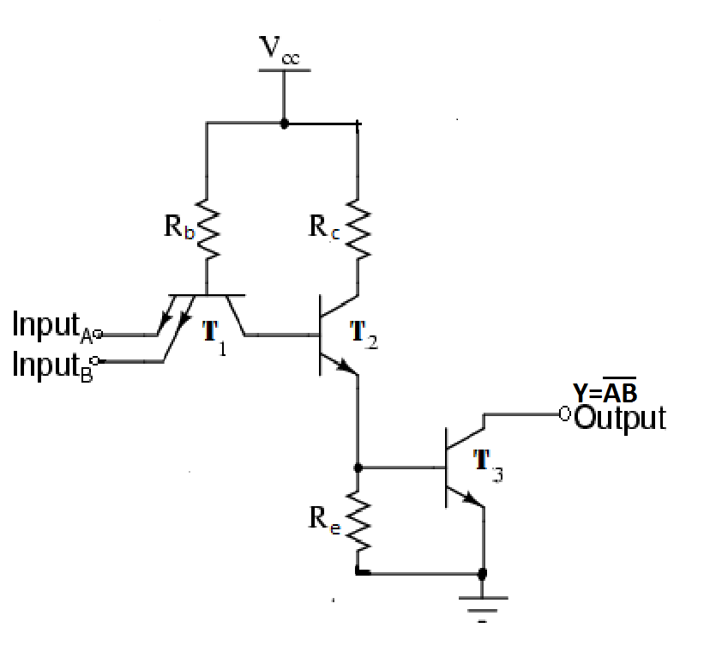
Open collector TTL nand gate
ttl nand gate

Slide 10

Open collector TTL NAND gate
In Open collector TTL circuit the output of T2 is given to input of T3 at base, the collector of it is open.
The collector of T2 & collector of T3 in phase, so this works as NAND gate.
This circuit needs an external Pull-Up resistor between the output and power supply for proper operation.
Disadvantage:
Low speed

Slide 11
Open collector TTL NAND gate
Disadvantage:
Low speed
If the output has change from Low to High, the Transistor T3 has to change from saturation to cutoff.
This means the charge carrier in the collector of T3 should be removed
As the current path is through the pull up resistor, more time is taken to change the output from 0 to 1.
This Disadvantage can be rectified by ‘Totem pole’.

Slide 12
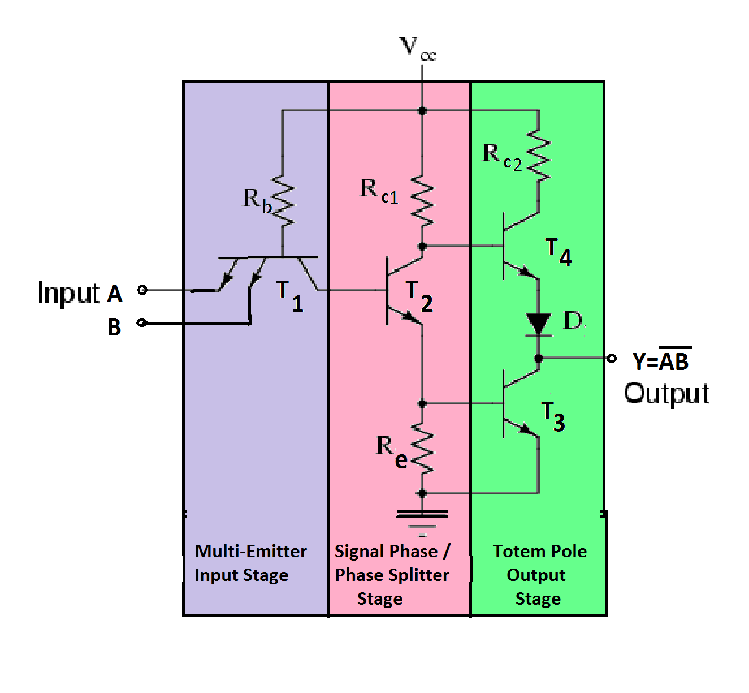
Totem pole TTL NAND gate
In TTL Logic circuit there are three stages
Multi Emitter Input Stage - where T1 has multiple input in emitter
Phase splitter stage – in this the T2 acts as switch that makes if T3 ON then T4 OFF If T3 OFF then T4 ON
Totem pole output stage- the out put is taken out between T3&T4.
INPUT | T1 | T2 | T3 | T4 | OUTPUT
0,0 0,1 1,0 | SATURATION | OFF | OFF | SATURATION | 1/HIGH
1,1 | CUTOFF | SATURATION | SATURATION | OFF | 0/ LOW

Slide 13
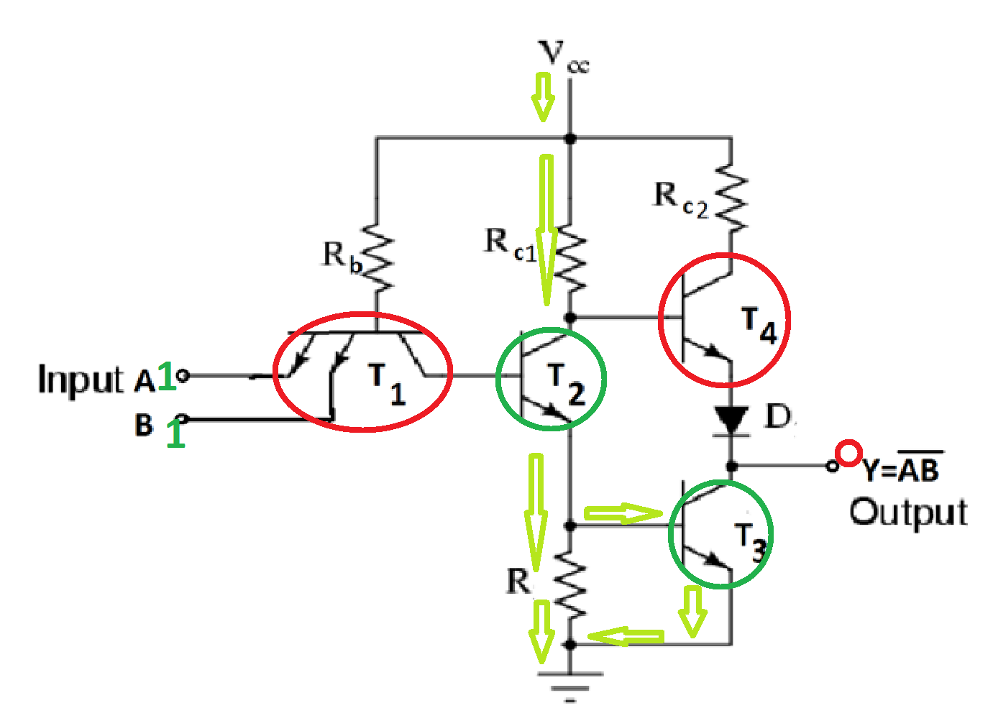
Totem pole TTL NAND gate
In Totem pole NAND gate circuit, the output is taken from T3.
When both input is ‘1’ then the T1 is in cutoff this makes T2 in saturation, so the current flows through T2&Re this makes T3 in Saturation.
So the output Y is LOW.
At this time T4 is also OFF(Vb<Ve)
Base is not higher than Emitter
Ve = D(0.8V)+T3(0.3V)
Vb= T2(0.3V)+T3 –Veb (0.7V)

Slide 14
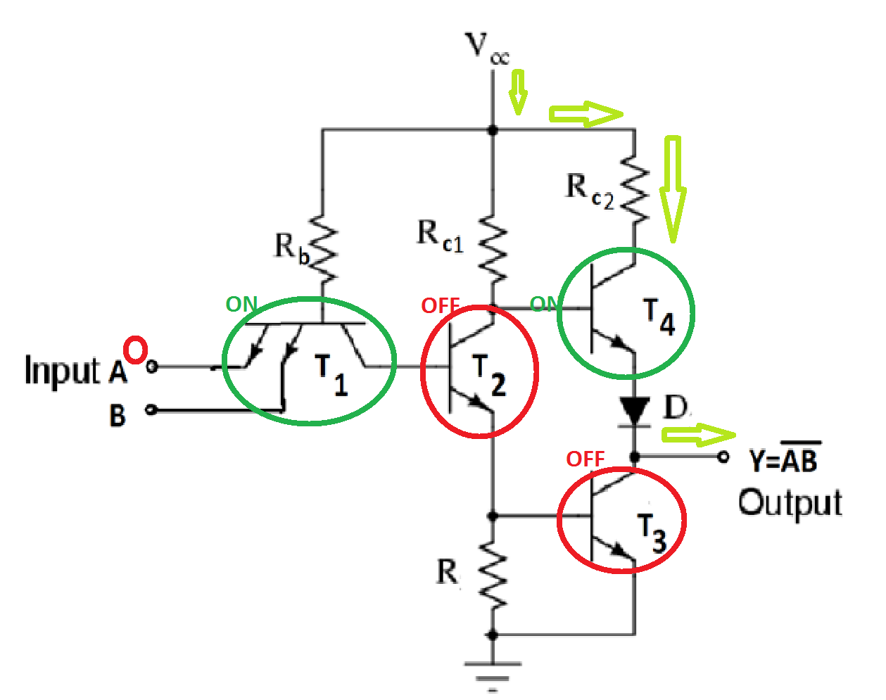
Totem pole TTL NAND gate
If any one of the input is made low ’0’ at T1 emitter , the corresponding emitter junction becomes conductive.
This makes T1 on ,T2&T3 off and the T4 is ON that makes output High. Then the circuit act as NAND gate.
So always one of the totem pole transistor is in ON state for giving low or High,the output impedance is low
thus the extra charge carrier passes
via ON transistor.
ADVANTAGES:
Low propagation delay
Low output Impedance
High Fan out

Slide 15
MOS/ CMOS CIRCUIT
Metal Oxide Semiconductor(MOS) field effect transistor. There are 3 types
P MOS- P- Channel MOSFET – slowest
N MOS – N Channel MOSFET – Microprocessor & Memories
C MOS (Complementary MOS) – both N& P Channel
ADVANTAGES:
LOW POWER DISSIPATION
LOW NOISE
HIGH FAN OUT
HIGH SWITCHING SPEED
BETTER COMPATIBILITY

Slide 16
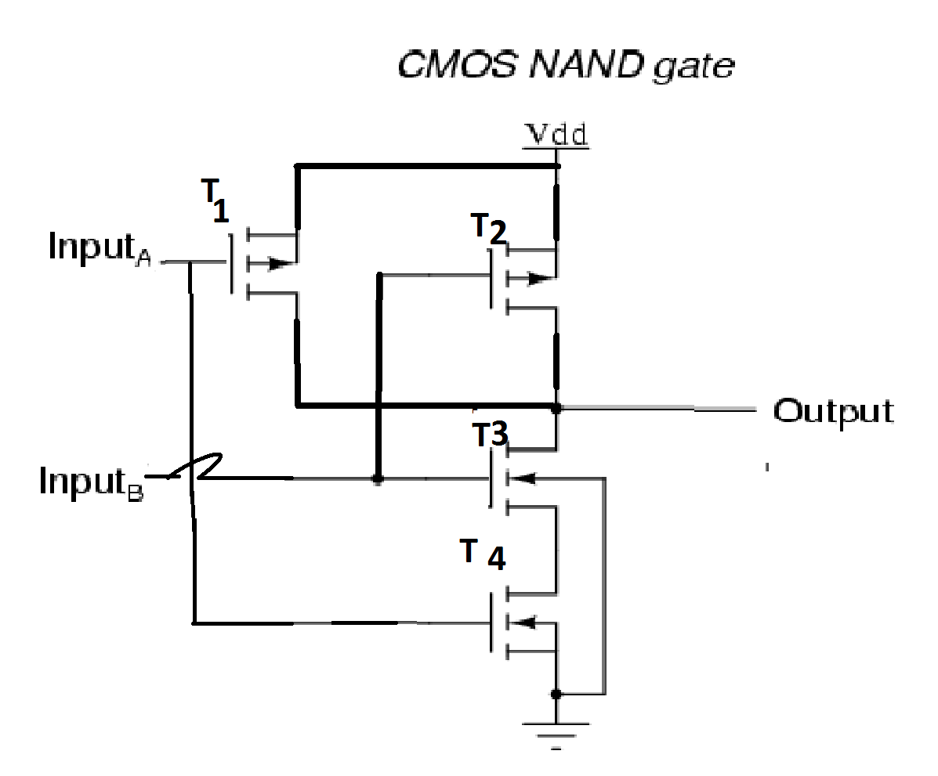
CMOS NAND GATE

Slide 17
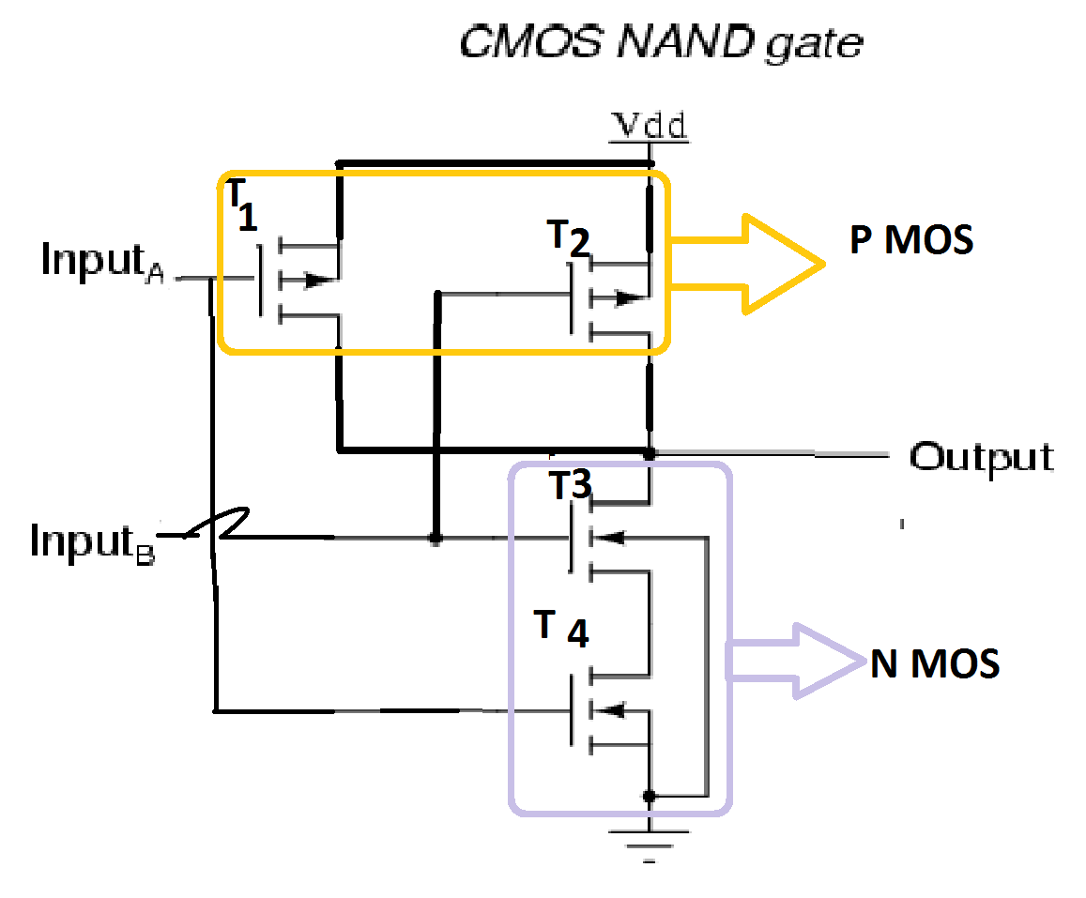
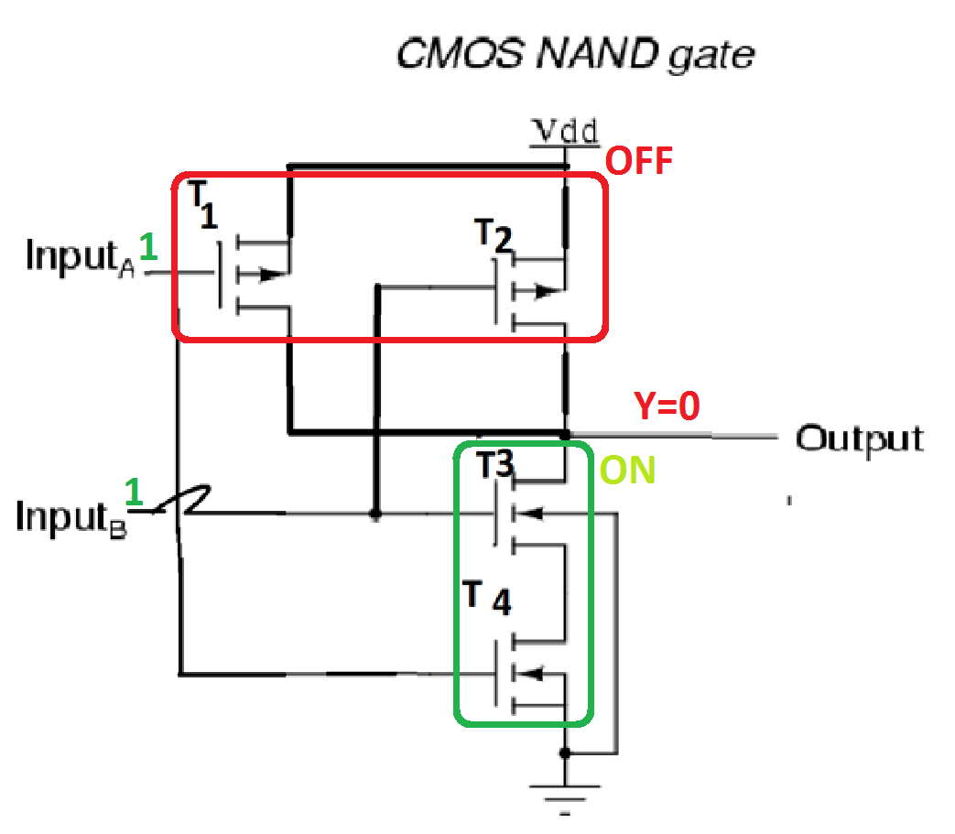
CMOS NAND GATE OPERATION
Complementary MOSFET
T1 & T2 are p-channel MOSFET
T3 & T4 are n-channel MOSFET
If inputs are high ‘1’ then p-channel MOSFET (T1 & T2 – OFF), n-channel MOSFET (T3& T4 – ON), so the output is low.

Slide 18
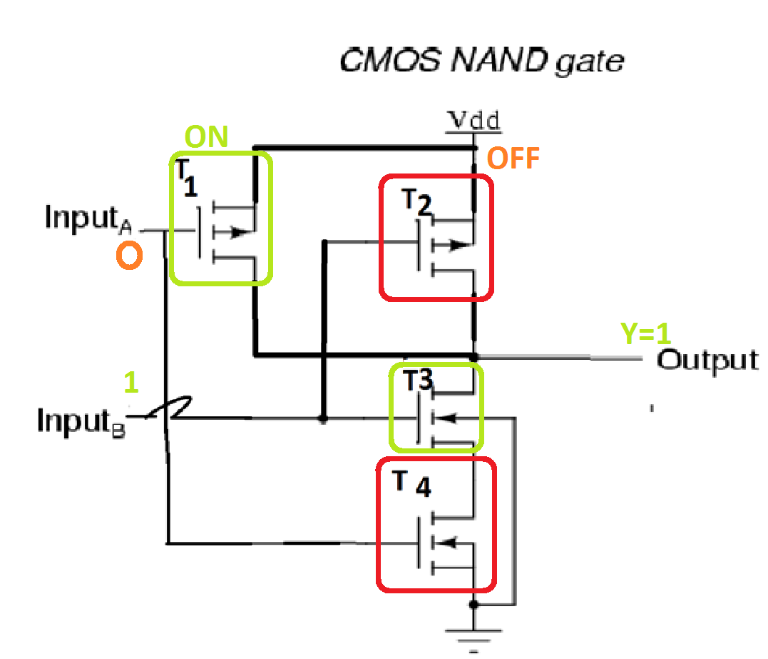
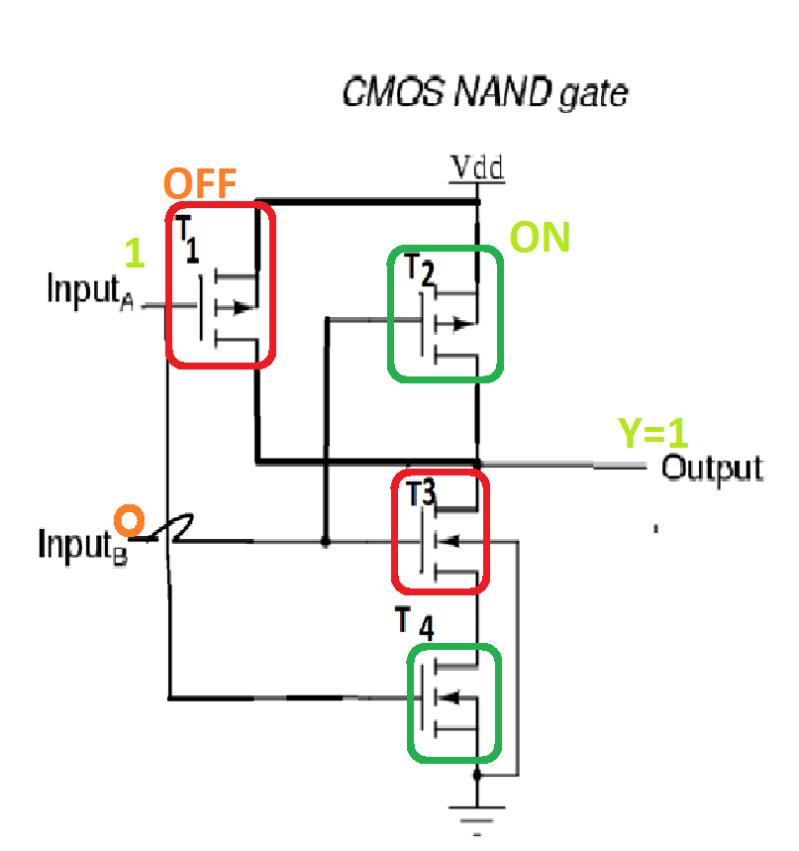
CMOS NAND GATE OPERATION
If any one of the input is high then the pmos transistor is OFF & its Combinational nmosTransistor is On
For Eg:
INPUT | T1 | T2 | T3 | T4 | OUTPUT
0,0 | ON | ON | OFF | OFF | 1/HIGH
0,1 | ON | OFF | ON | OFF | 1/HIGH
1,0 | OFF | ON | OFF | ON | 1/HIGH
1,1 | OFF | OFF | ON | ON | 0/ LOW

Slide 19
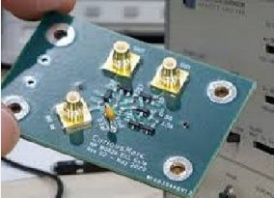
EMITTER COUPLED LOGIC(ECL)
ECL is the fastest among all logic families
The basic component is current switch or difference amplifier with out-of phase output .
This reason ECL is known as Current Mode Logic(CML)
Transistor operates on Non- saturated at limited collector current, so the emitter coupling is used, it doesn't allow transistor to saturate.
ADV: [1]. So switching speed is high, [2]. propagation delay is >3ns and [3]High Fan – in & out.
DIS: [1] Highest power dissipation [2] additional reference voltage source. so it is used in Superfast computing.

Slide 20
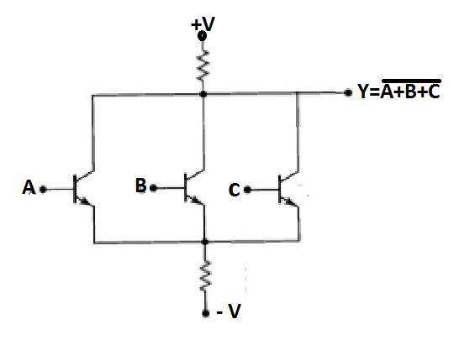
ECL NOR GATE:
OPERATION:
If one of the input or all the input are high then the output is low because one or more transistor conducts.
Output is high when all input is low

Slide 21
Comparison of TTL, CMOS & ECL logic family
S.NO | CHARECERIZATION | TTL | CMOS | ECL
1 | GATES | NAND | NAND/NOR | NOR
2 | Noise ImmunityVin (V) | 0.50 | 1.50 | 0.16
3 | Fan out Fout | >10 | >10 | >10
4 | Fan in Fin | 12 to 14 | >10 | >10
5 | Propagation Delay tpd (ns) | 15 | 15 | < 3
6 | Power Dissipation Pd (mw) | 0.1 | 175 | 0.001

Slide 22
Thank You

